Slide 1
ULTRASONICS

Slide 2
Introduction to Ultrasonics
Characteristics of Ultrasonic waves
Ultrasonic Production-
Inverse Piezo Electric Method
Applications of UltrasoniCS
(Thickness measurement and Flaw detection)

Slide 3
Introduction to Ultrasonics
The word ultrasonic combines the Latin roots ultra, meaning ‘beyond’ and sonic, or sound.
The sound waves having frequencies above the audible range i.e. above 20000Hz are called ultrasonic waves.
Generally these waves are called as high frequency waves.

Slide 4
Characteristics of Ultrasonic Waves
1. It has the frequency greater than 20KHz.
2.They can not travel in vacuum.
3.The speed of ultrasonic waves increases with increasing
frequency.
4.These are short wavelength and high frequency sound waves.
5. ultasonic waves can travel a long distance without any deviation
and without appreciable loss of energy.
6. Due to short wavelength ,the penetration power of these waves
is large.
7. For homogeneous medium ,the velocity of ultasonic waves
remains same when travel through it.

Slide 5
Ultrasonic Production
Ultrasonic waves are produced by the
following methods.
(1) Inverse Piezo-electric effect using transistor

Slide 6
Piezo Electric Oscillator
Principle : Inverse piezo electric effect
If mechanical pressure is applied to one pair of opposite faces of certain crystals like quartz, equal and opposite electrical charges appear across its other faces.This is called as piezo-electric effect.
The converse of piezo electric effect is also true.
If an electric field is applied to one pair of faces, the corresponding changes in the dimensions of the other pair of faces of the crystal are produced. This is known as inverse piezo electric effect or electrostriction.

Slide 7
Due to application application of external voltage, mechanical deformation occurs in the crystal.
Crystal oscillates along its length or thickness
When applied voltage has same polarity , crystal expand and iif applied voltage has opposite polarity crystal compress
During resonance it produces the ultrasonic waves of very high frequency greater tham 1MHz.

Slide 8
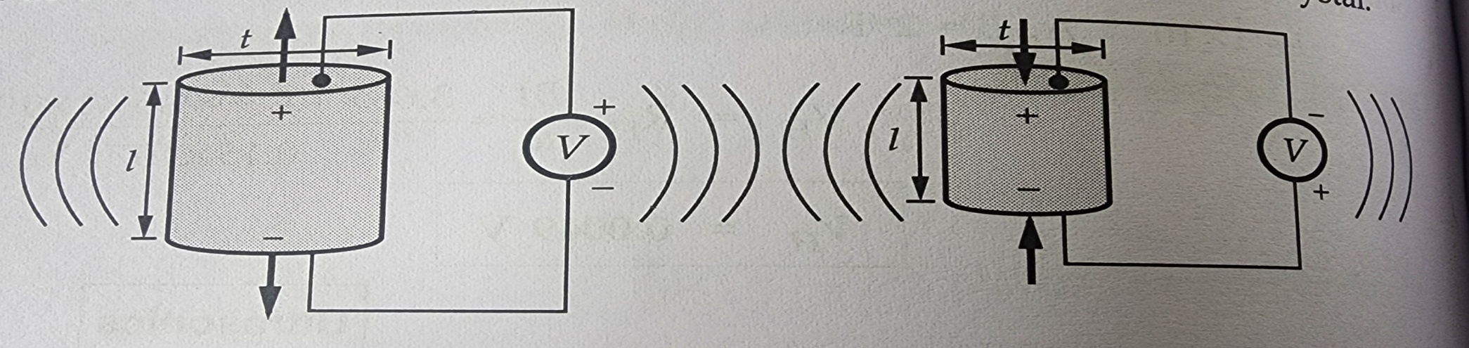
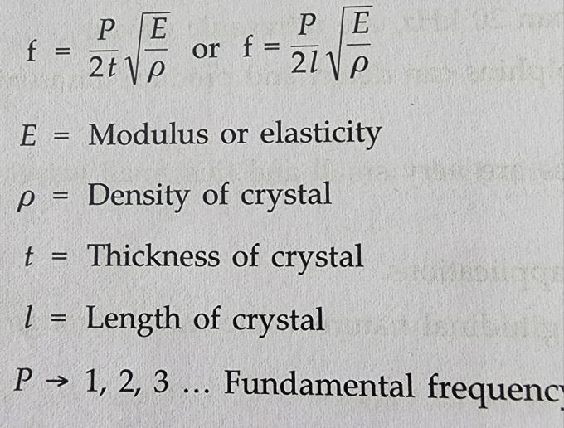
Expansion
Compression

Slide 9
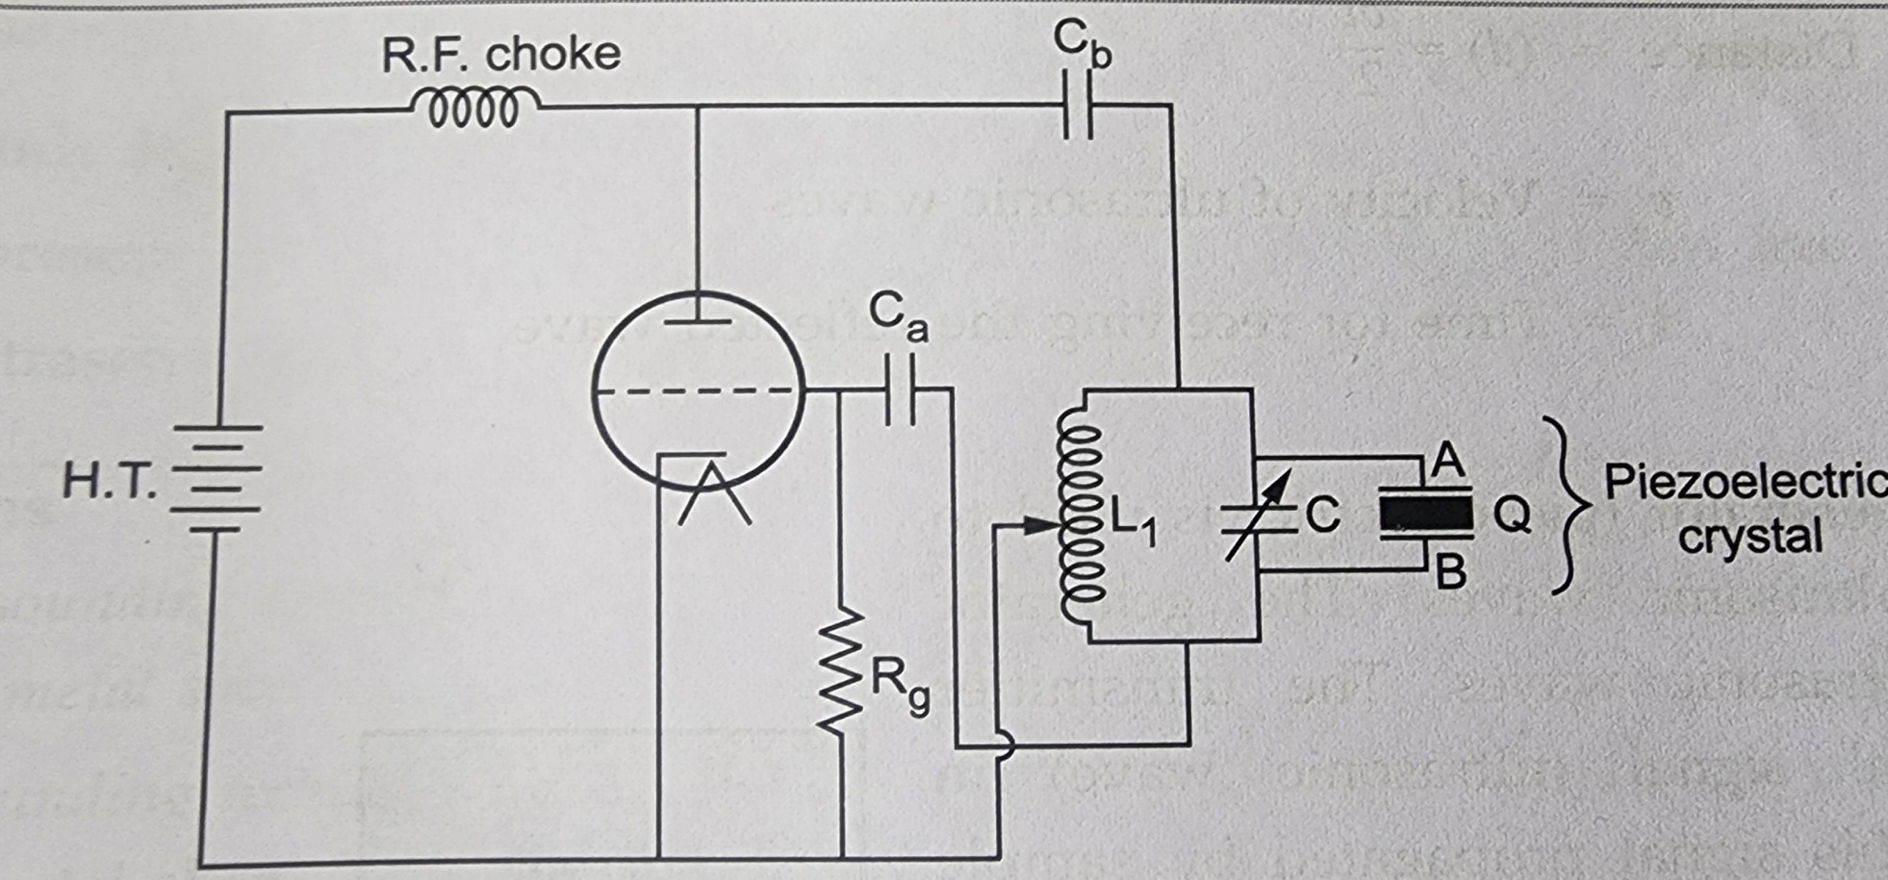
Piezoelectric oscillator Construction
The circuit diagram is shown in Figure

Slide 10
The quartz crystal is placed between two metal plates A and B.
LC oscillatory circuit is used which is connected to crystal and transistor.
High frequency waves of frequency upto 50MHZ can be generated.
When alternating current apply to crystal it oscillates and if resonance occurred ,it produces ultrasonic waves.
Because of high frequency electrical signal applied to it,the piezoelectric crystal produces ultrasonic waves having freq.greater than 500KHZ

Slide 11
Advantages
Single frequency output can be obtained.
High frequency waves of frequency upto 50MHZ can be generated.
It does not affect by temp. and humidity.
Disadvantages
The cost of piezo electric quartz is very high
The cutting and shaping of quartz crystal are very complex.

Slide 12
Applications of Ultrasonic Waves in Engineering
1. Thickness Measurement
When ultrasonic wave travel from medium it produces echo when reflected by obstacle
Principle: The transmitted ultrasonic wave travel through medium and reflected wave received by receiver.

Slide 13
Applications of Ultrasonic Waves in Engineering
1.Thickness Measurement
When ultrasonic wave travel from medium it produces echo when reflected by obstacle
Principle: The transmitted ultrasonic wave travel through medium and reflected wave received by receiver.

Slide 14
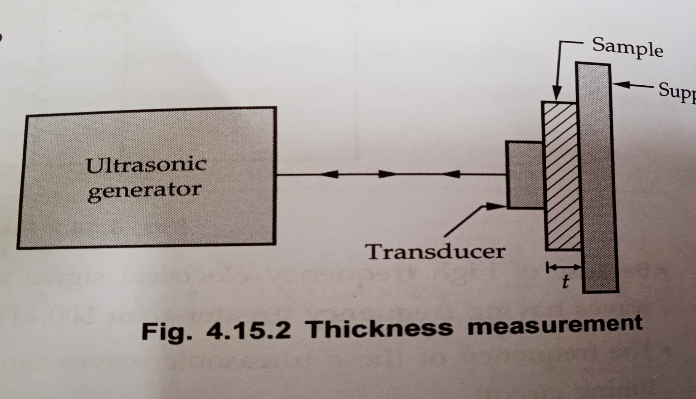
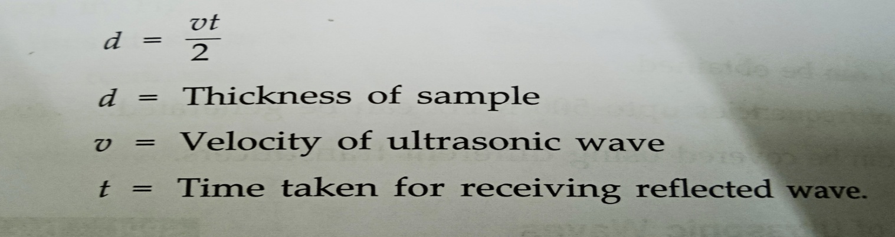

Slide 15
Applications of Ultrasonic Waves in Engineering
(2)Detection of flaws in metals
Ultrasonic waves are used to detect the presence of flaws or defects in the form of cracks, blowholes porosity etc., in the internal structure of a material
Principle
The ultrasonic waves generator transmit the wave ,it get reflected by top ,bottom surface of sample and from flaw. The receiving signal recorded by CRO,

Slide 16
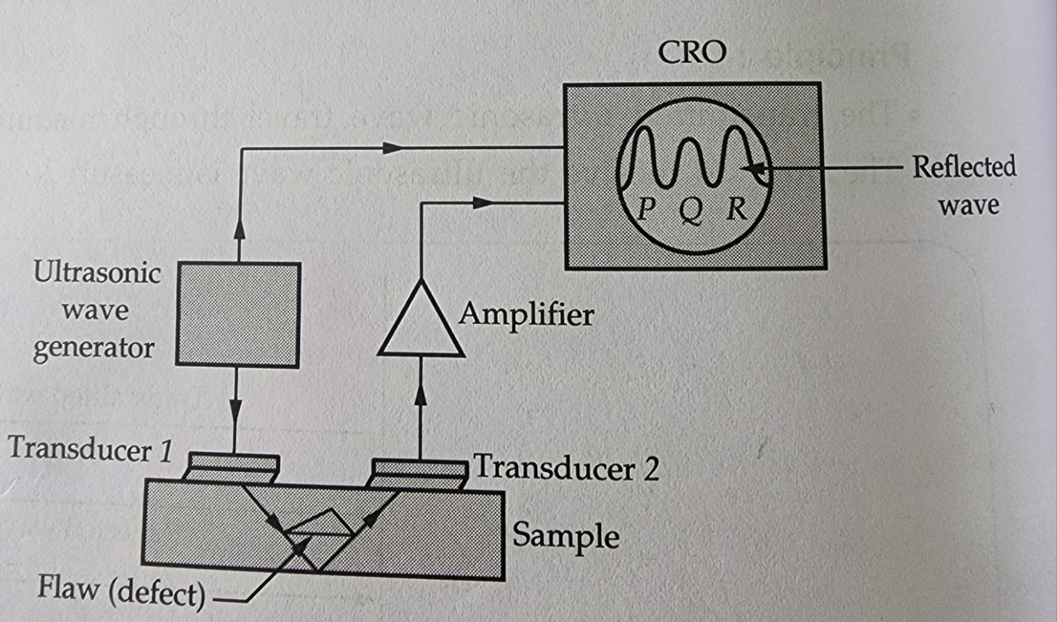
Experimental setup
It consists of an ultrasonic frequency generator and a cathode ray oscilloscope (CRO),transmitting transducer(A), receiving transducer(B) and an amplifier.

Slide 17
Working
The ultrasonic waves generated produced the ultrasonic waves in the form of electric pulse.This pulse is get converted into optical signal by transducer 1.
The optical signal prapogated through sample. It get reflected by flaws if present in the sample and bottom of sample.
The reflected signal converted to electrical pulse using transducer 2.
Amplifier amplifies the signal.

Slide 18
The amplified signal/pulse is then observed on CRO.
Three P,Q,R three peaks are observed on the screen.
P:Amplitude due to transmitted wave
Q:Amplitude due to reflected wave from flaws
R:Amplitude due to reflected wave from bottom of sample

Slide 19
Features
This method is used to detect flaws in all common structural metals and other materials like rubber tyres etc.
The method is very cheap and of high speed of operation.
It is more accurate than radiography.

Slide 20
THANK YOU

